Slide 1
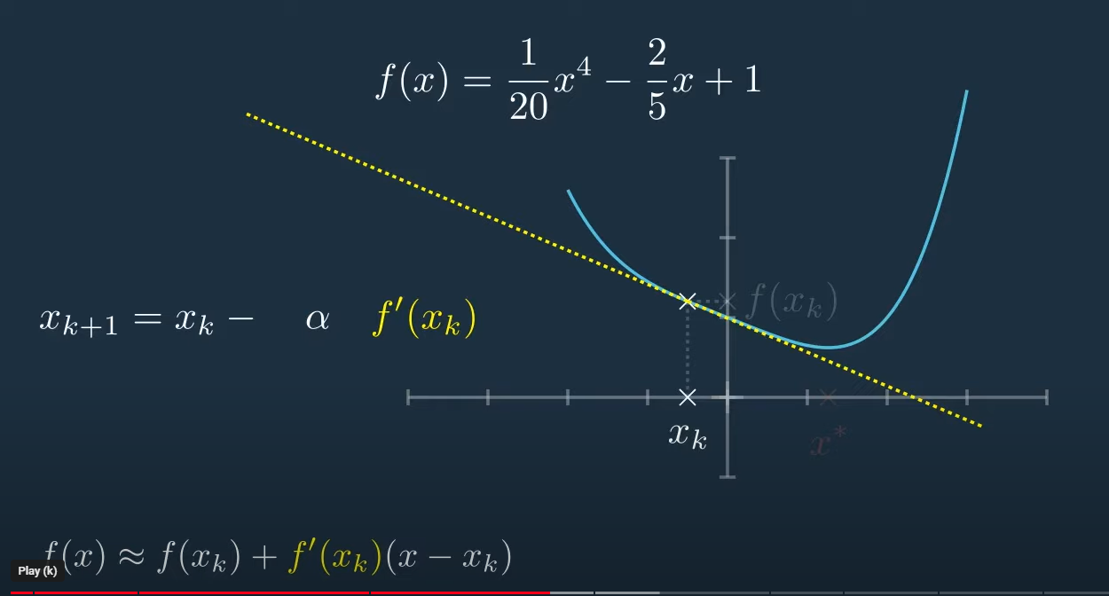
https://www.youtube.com/watch?v=W7S94pq5Xuo

Slide 2
